Slide 1
JavaScript Animation Using
Using ANIME.js

Slide 2
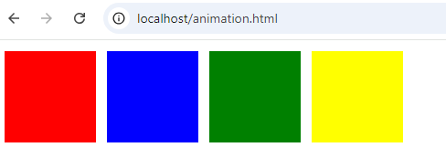
Requirements
Anime.js
A code editor
A Browser
Step 1. Start by building a web interface using HTML and CSS
Our web interface makes use of four divisions in the body as seen in the code bellow

Slide 3
HTML
<DOCTYPE html>
<html lang="en"><head>
<meta charset="UTF-8">
<meta name="viewport" content="width=device-width" initial-scale=1.0">
<meta http-equiv="X-UA-Compatible" content="ie=edge">
<link rel="stylesheet" type="text/css" href="style.css">
<title>anime app</title>
</head>
<body>
<div class="box red"></div>
<div class="box blue"></div>
<div class="box green"></div>
<div class="box yellow"></div>
<script src="https://cdnjs.cloudflare.com/ajax/libs/animejs/2.0.2/anime.js"type="text/javascript"></script>
<script src="main.js"></script>
</body>
</html>

Slide 4
StyleSheets
Step 2: Write the style sheet that we are linking our web interface to
Here we are setting the width, height, margins and background of our divisions as in the code bellow
.box{
position: relative;
width:100px;
height:100px;
margin:4px;
display:inline-block;
}
.red{background-color:red}
.blue{background-color:blue}
.green{background-color:green}
.yellow{background-color:yellow}

Slide 5
The JavaScript
Step 3: Writing the JavaScript Logic for the Animation
We try this for the first div and check the resultant behavior in a browse (It helps to have the browser open alongside your editor)
anime({
targets:'div.box.red',
translateY:[
{value:200,duration:500},
{value:0,duration:800},
],
rotate:{
value:'1turn',
easing:'easeInOutSine',
}
});

Slide 6
More Code
Try repeating the same code for the other division i.e. ensuring that you increase the delay by 1000(1 second) for both translate and rotate such that each division translates and rotates one at a time.
targets:'div.box.blue',
translateY:[
{value:200,duration:500, delay:1000},
{value:0,duration:800},
],
rotate:{
value:'1turn',
easing:'easeInOutSine',
delay;1000
}
});

Slide 7
Code for Green DIV
targets:'div.box.green',
translateY:[
{value:200,duration:500, delay:2000},
{value:0,duration:800},
],
rotate:{
value:'1turn',
easing:'easeInOutSine',
delay;2000
}
});

Slide 8
Now Do for Yellow

Slide 9

Desired Behaviour

Slide 10
Automation Fuction
: Let’s Try automating with a function. Remove all the JavaScript for the DIV section and replace with the code bellow
anime({
targets:'div.box',
translateY:[
{value:200,duration:500},
{value:0,duration:800},
],
rotate:{
value:'1turn',
easing:'easeInOutSine',
},
delay:function (e1,i,l){return i*1000}
});

Slide 11
Task
Now Build an animation with enough divisions for every letter to spell your name.

